Slide 1
Grampa, what's a deleted tweet?
Mohammed Nauman Siddique
Web Archiving Forensics (CS 895)
Spring, 2019

Slide 2
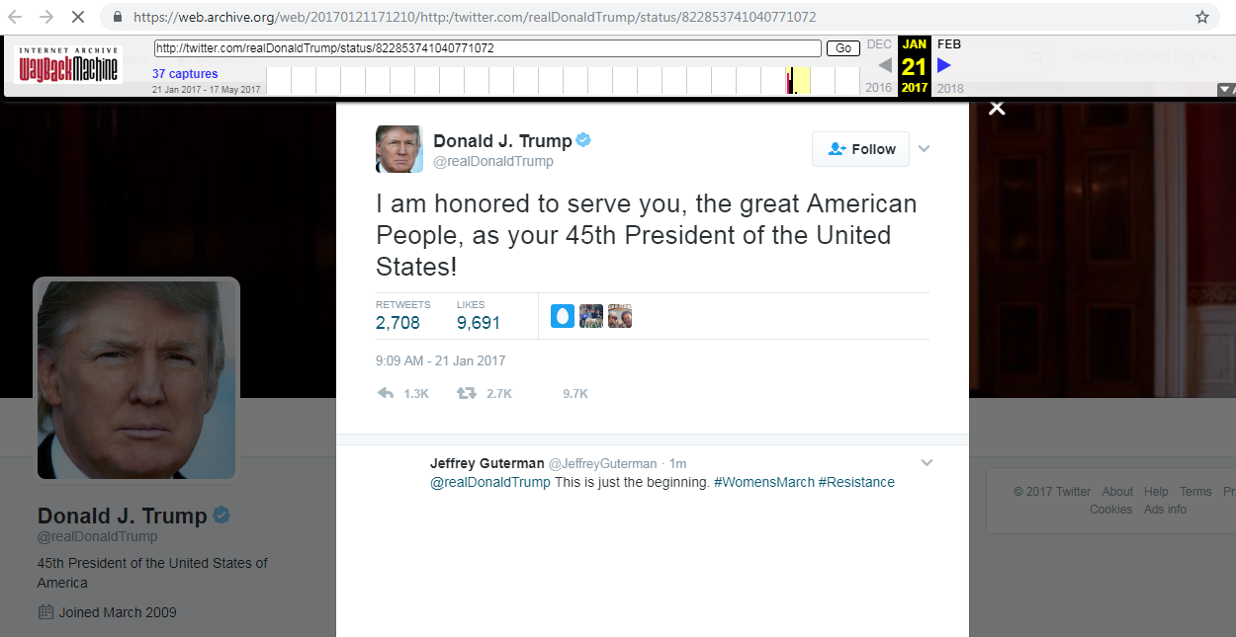
Presidential tweets are now government records
Source: https://web.archive.org/web/20170121171210/http:/twitter.com/realDonaldTrump/status/822853741040771072
News Article: https://theconversation.com/donald-trumps-tweets-are-now-presidential-records-71973

Slide 3
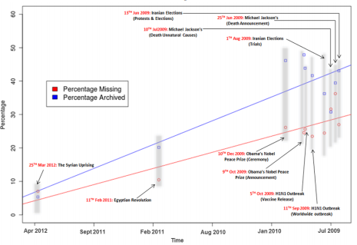
11% of the social media resources are lost in their first year
Source: SalahEldeen H.M., Nelson M.L. (2012) Losing My Revolution: How Many Resources Shared on Social Media Have Been Lost?. TPDL 2012. Springer, Berlin, Heidelberg
Blog Link: http://ws-dl.blogspot.com/2012/02/2012-02-11-losing-my-revolution-year.html

Slide 4
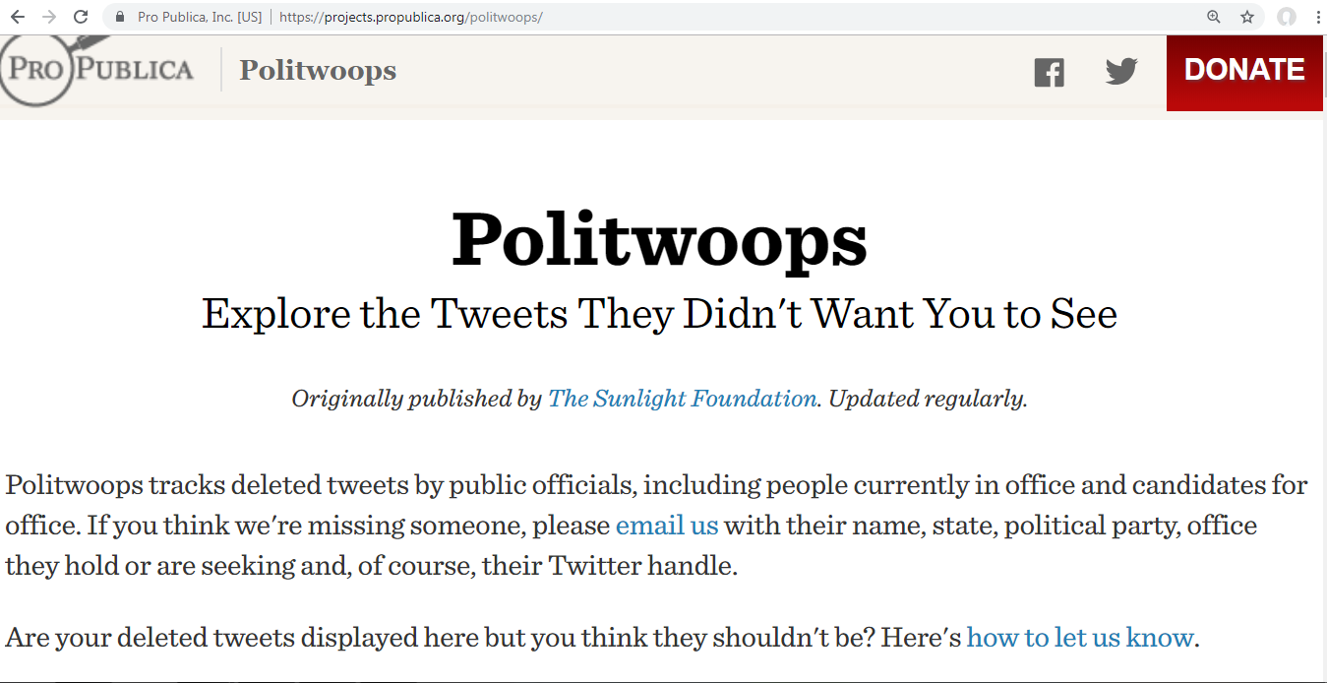
Politwoops: Tracks deleted tweets by public officials
Source: https://projects.propublica.org/politwoops/

Slide 5
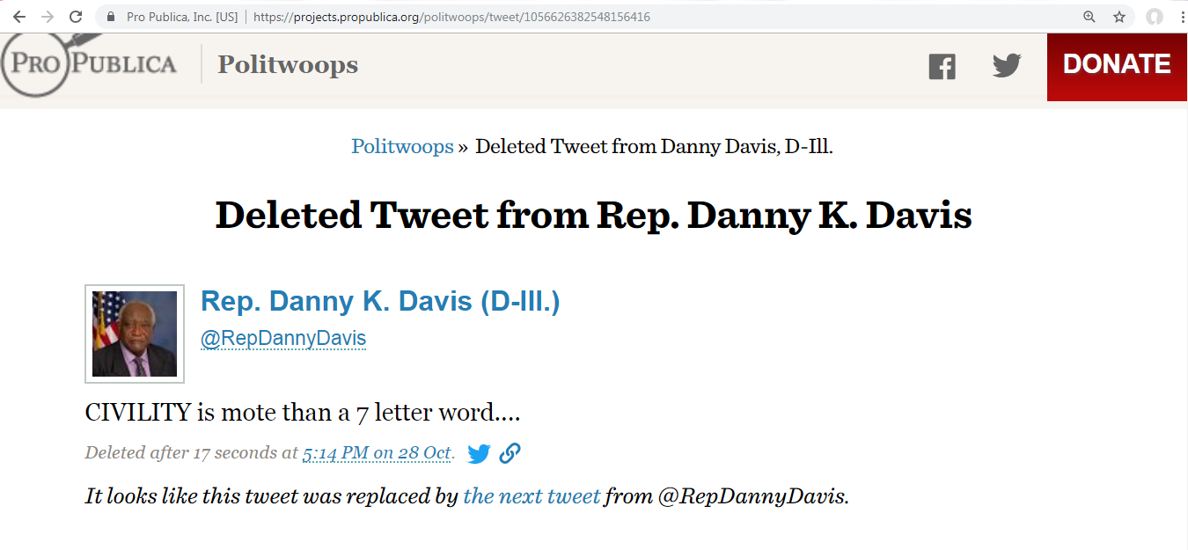
The best way to find a typo is to hit send
Source: https://projects.propublica.org/politwoops/tweet/1056626382548156416

Slide 6
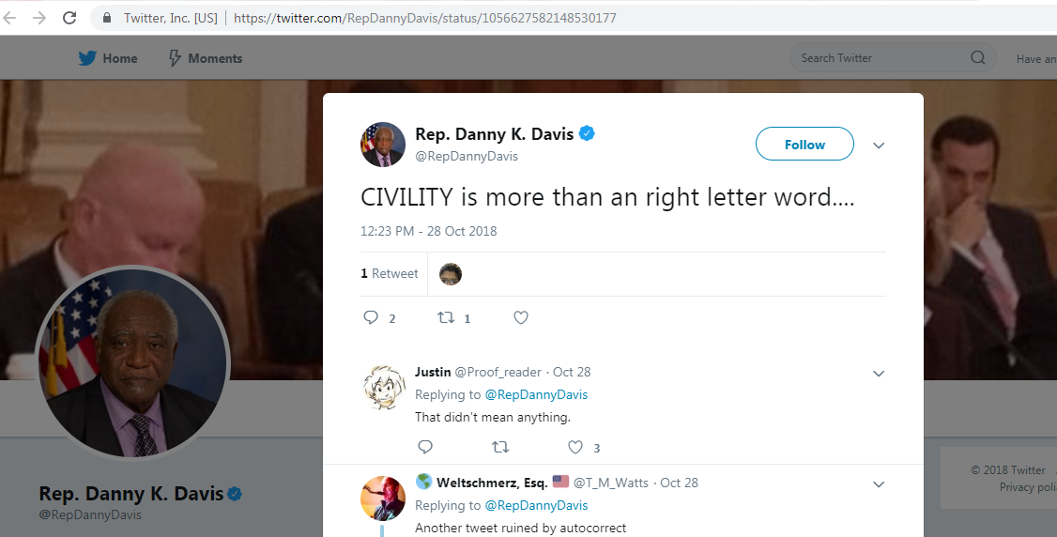
Fixing typos only introduces more typos
Source: https://twitter.com/RepDannyDavis/status/1056627582148530177

Slide 7
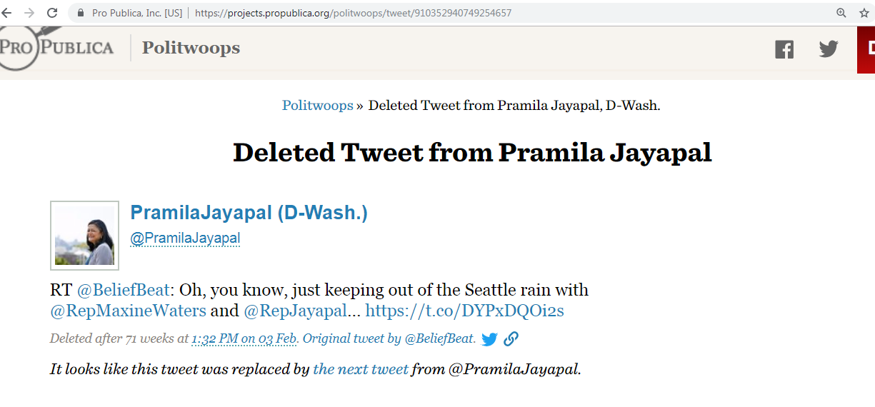
Unretweeted after a year!!!
Source: https://projects.propublica.org/politwoops/tweet/910352940749254657

Slide 8
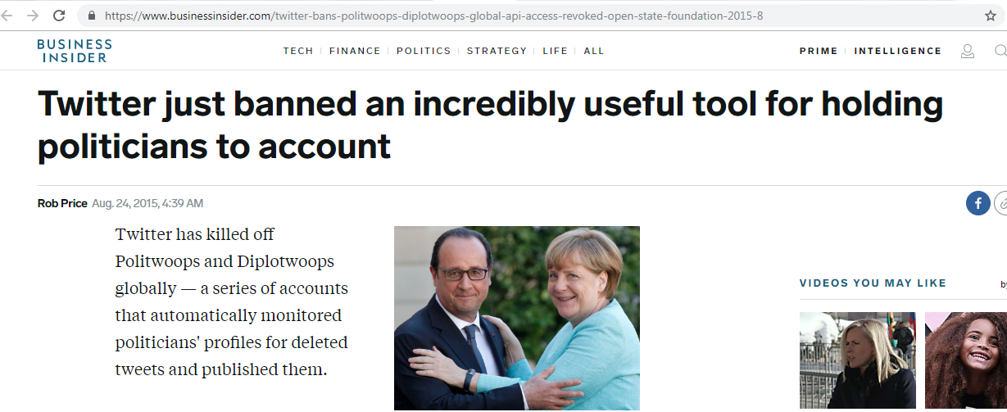
Twitter revoked access to Politwoops
Source: https://www.businessinsider.com/twitter-bans-politwoops-diplotwoops-global-api-access-revoked-open-state-foundation-2015-8/

Slide 9
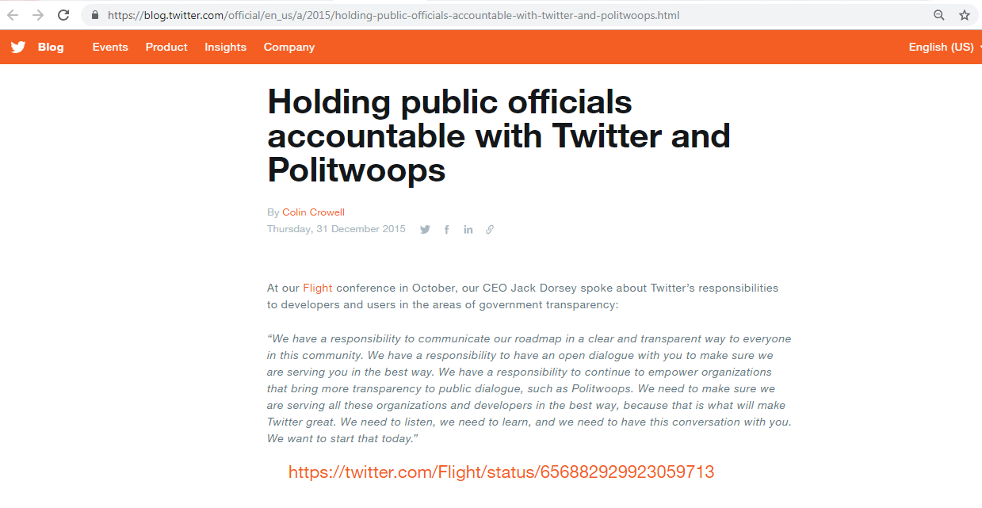
Politwoops resumes after 6 months
Tweet is deleted
Source: https://blog.twitter.com/official/en_us/a/2015/holding-public-officials-accountable-with-twitter-and-politwoops.html

Slide 10
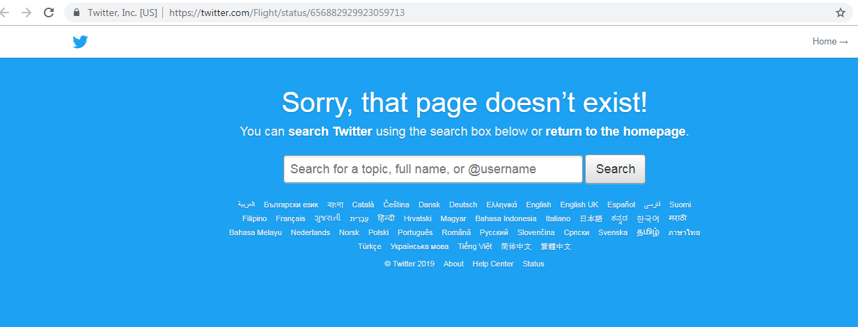
Flight handle is gone
Source: https://twitter.com/Flight/status/656882929923059713

Slide 11
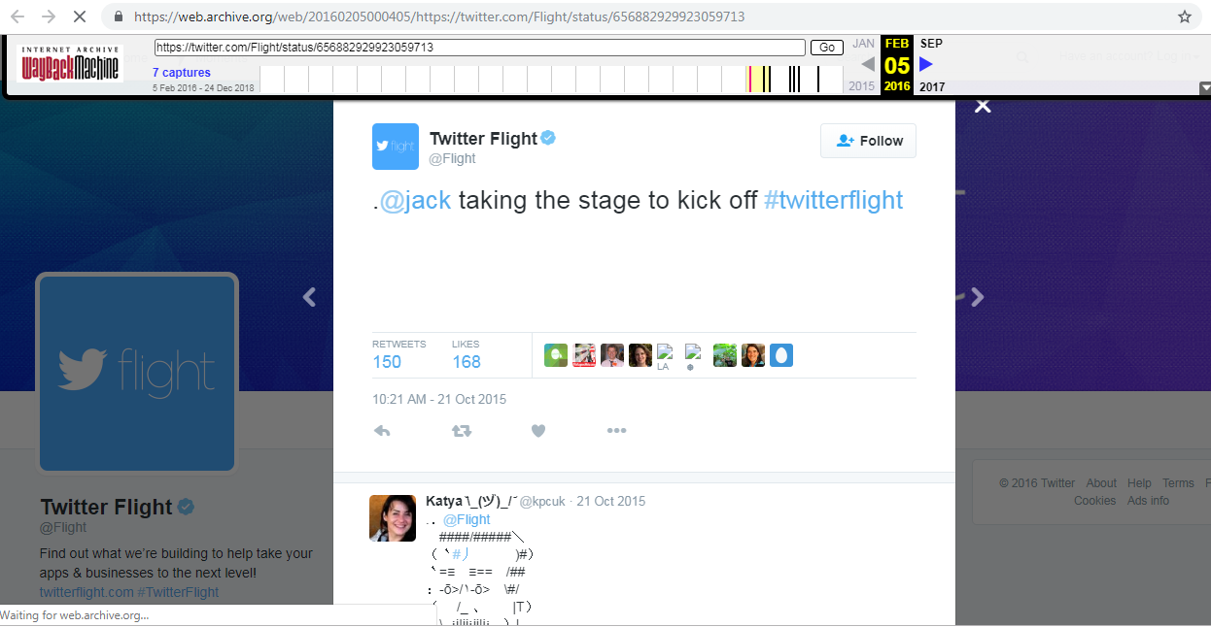
No worries web archives come to the rescue
Source: https://web.archive.org/web/20160205000405/https://twitter.com/Flight/status/656882929923059713

Slide 12

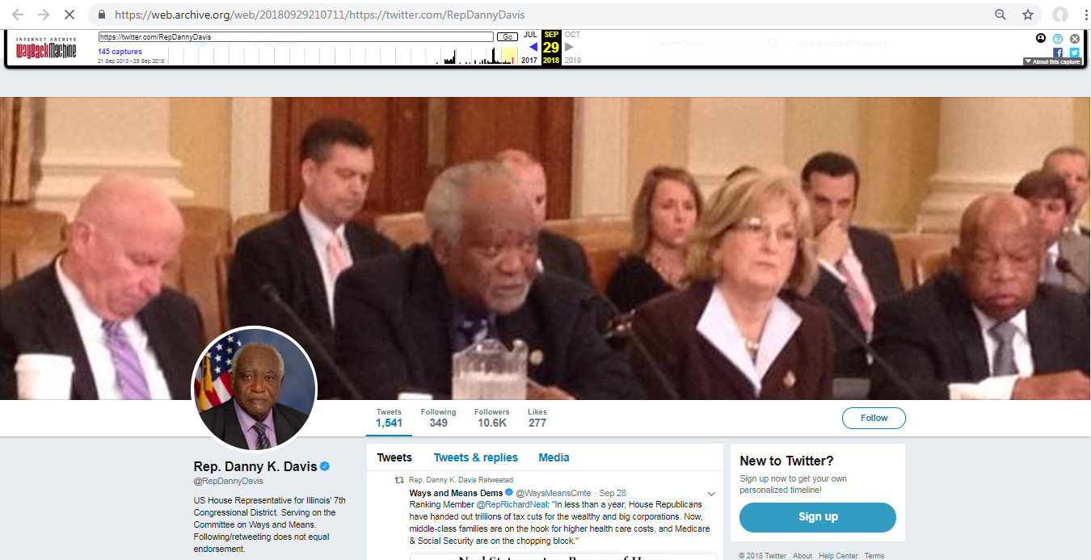



Web archives include social media too
Source: https://web.archive.org/web/20180929210711/https:/twitter.com/RepDannyDavis

Slide 13
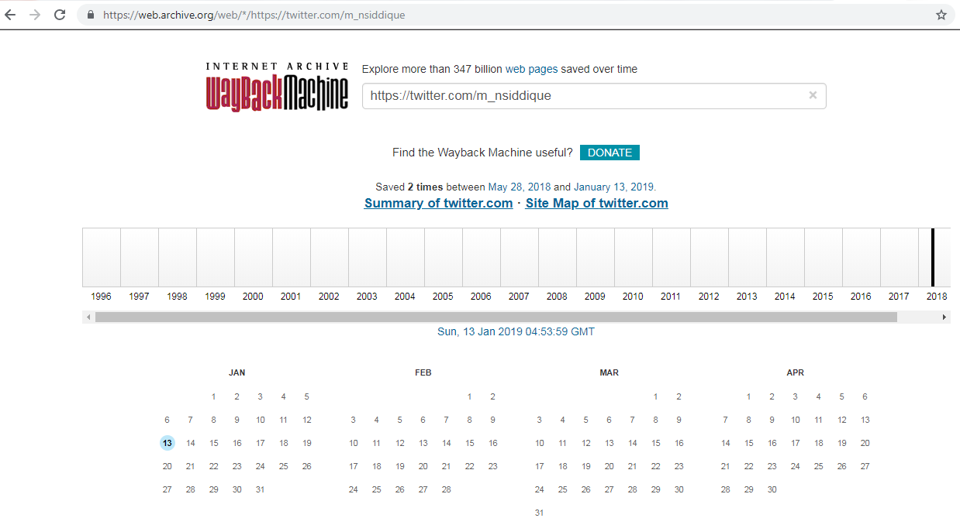
Nauman, you are not archived
Source: https://web.archive.org/web/*/https://twitter.com/m_nsiddique

Slide 14
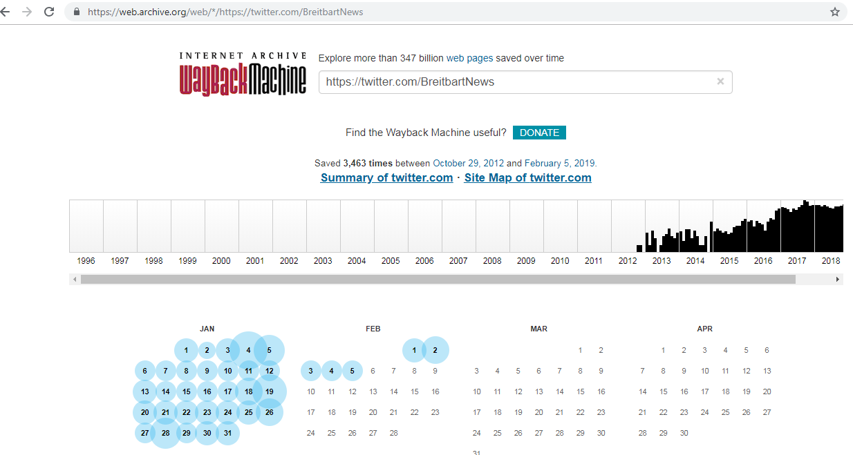
@BreitbartNews is well archived
Source: https://web.archive.org/web/*/https://twitter.com/BreitbartNews

Slide 15
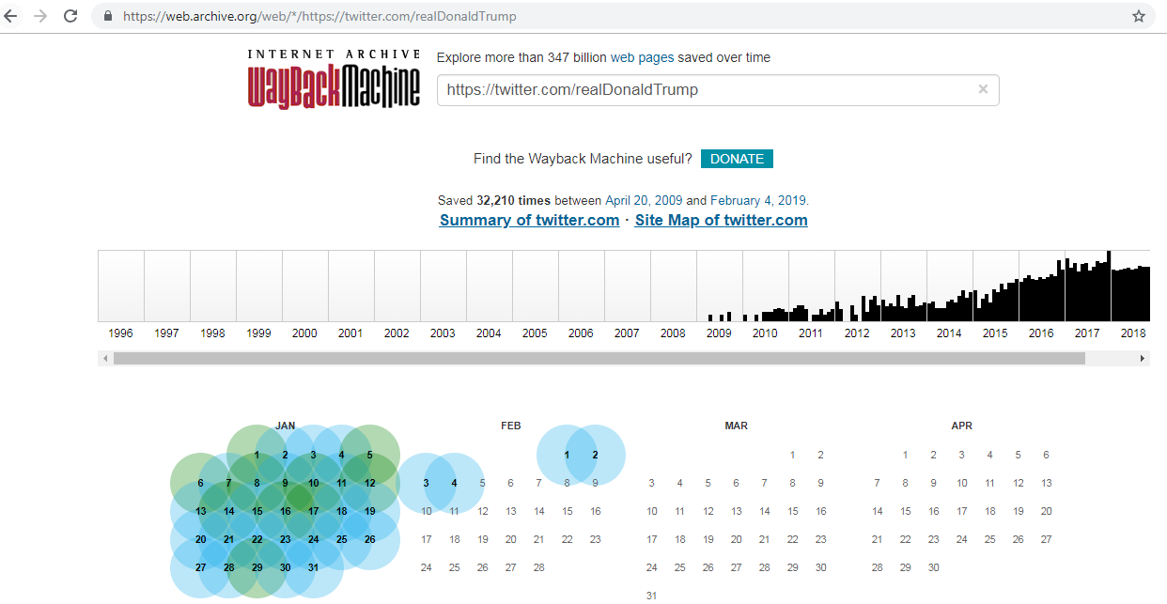
@realDonaldTrump is very heavily archived
Source: https://web.archive.org/web/*/https://twitter.com/realDonaldTrump

Slide 16
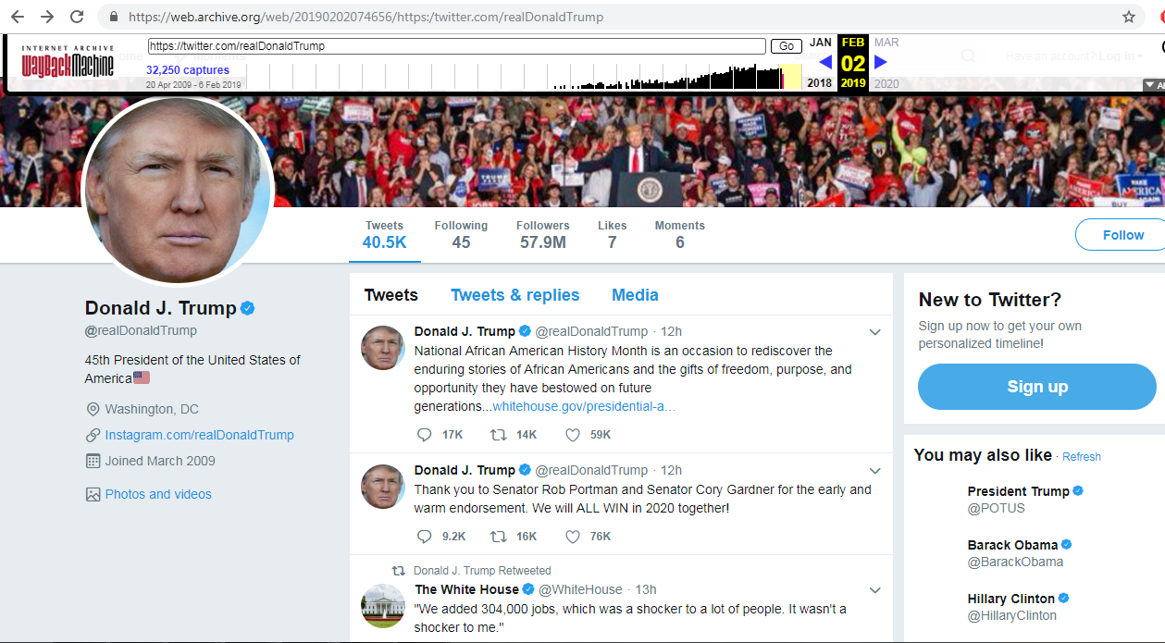
Archival captures for top level pages have approximately 20 tweets
Source: https://web.archive.org/web/20190202074656/https:/twitter.com/realDonaldTrump

Slide 17
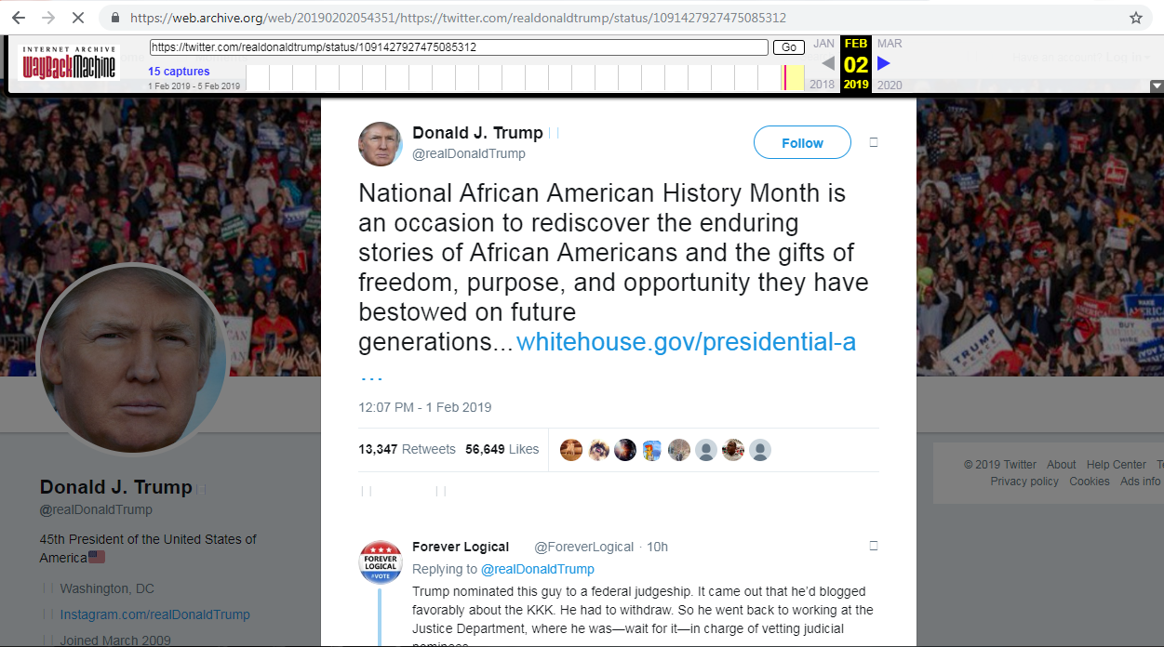
Tweet Ids are just a single tweet
Source: https://web.archive.org/web/20190202054351/https://twitter.com/realdonaldtrump/status/1091427927475085312

Slide 18
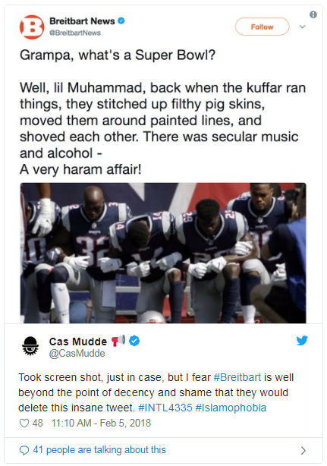
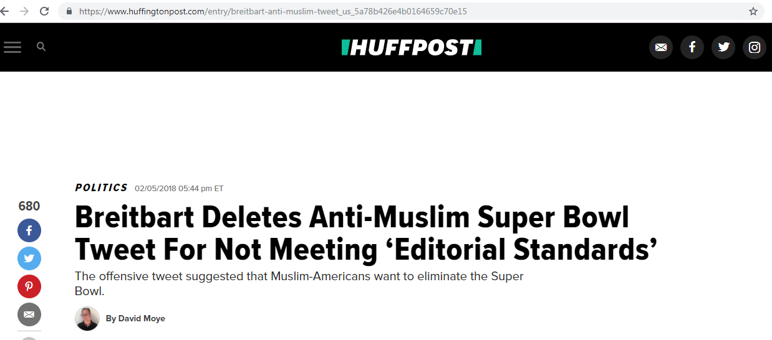
Not enough to take screenshots
News Article: https://www.huffingtonpost.com/entry/
breitbart-anti-muslim-tweet_us_5a78b426e4b0164659c70e15
Source: https://twitter.com/CasMudde/status/960546130684768256

Slide 19
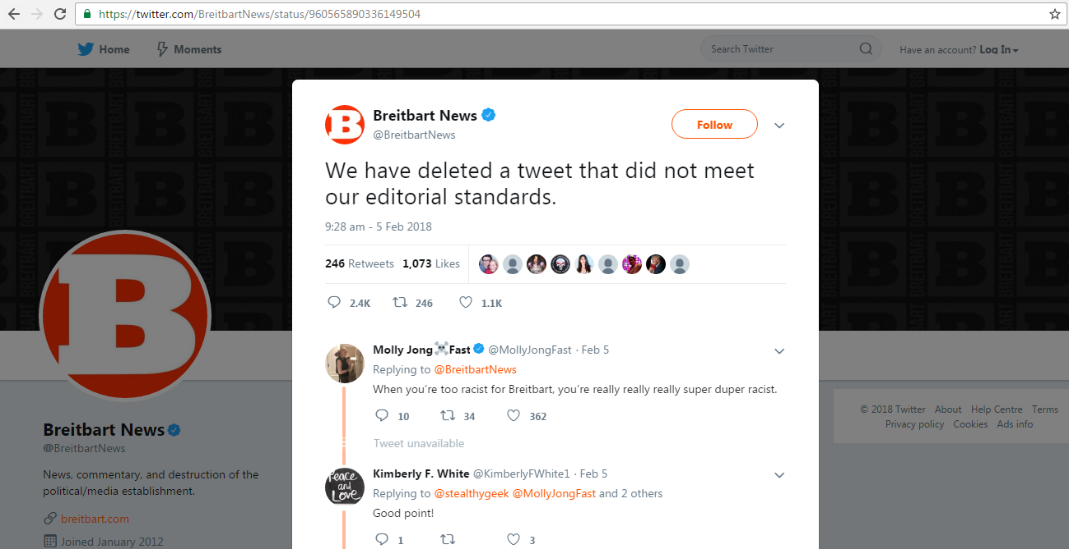
Monday Morning Quarterbacking
Source: https://twitter.com/BreitbartNews/status/960565890336149504

Slide 20
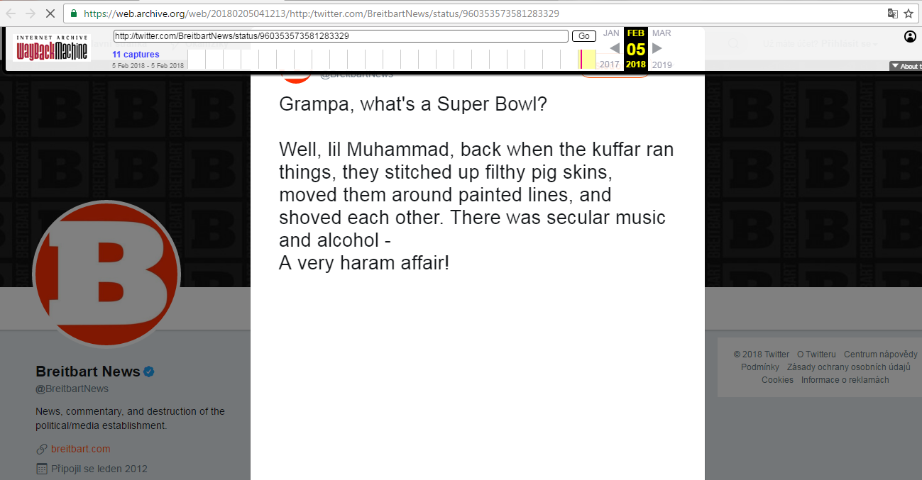
Penalty: Unsportsmanlike conduct
Source: https://web.archive.org/web/20180205041213/http:/twitter.com/BreitbartNews/status/960353573581283329

Slide 21
How did we find the deleted tweets?
Used Twitter API to fetch recent 3200 tweets
Tweets spanned from Oct 22, 2017 to Feb 18, 2018
Used Memgator, memento aggregator service to fetch mementos

Slide 22
Code to fetch recent tweets using Python-Twitter API
import twitter
api = twitter.Api(consumer_key='xxxxxx',
consumer_secret='xxxxxx',
access_token_key='xxxxxx',
access_token_secret='xxxxxx',
sleep_on_rate_limit=True)
twitter_response = api.GetUserTimeline(screen_name=screen_name , count=200, include_rts=True)

Slide 23
Run MemGator locally
$ memgator --contimeout=10s --agent=XXXXXX server
MemGator 1.0-rc7
_____ _______ __
/ \ _____ _____ / _____/______/ |___________
/ Y Y \/ __ \/ \/ \ ___\__ \ _/ _ \_ _ \
/ | | \ ___/ Y Y \ \_\ \/ __ | | |_| | | \/
\__/___\__/\____\__|_|__/\_______/_____|__|\___/|__|
TimeMap : http://localhost:1208/timemap/{FORMAT}/{URI-R}
TimeGate : http://localhost:1208/timegate/{URI-R} [Accept-Datetime]
Memento : http://localhost:1208/memento[/{FORMAT}|proxy]/{DATETIME}/{URI-R}
# FORMAT => link|json|cdxj
# DATETIME => YYYY[MM[DD[hh[mm[ss]]]]]
# Accept-Datetime => Header in RFC1123 format
Source: https://github.com/oduwsdl/MemGator

Slide 24
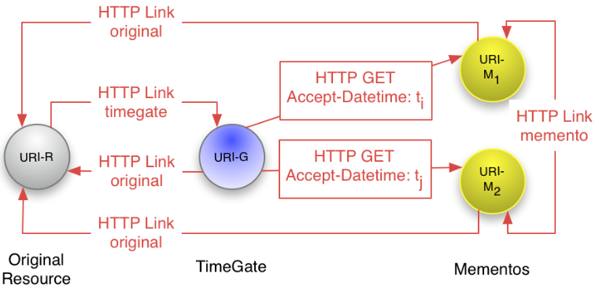
TimeGate
RFC: https://tools.ietf.org/html/rfc7089
Source: http://mementoweb.org/guide/quick-intro/

Slide 25
TimeMap
msiddique@atria:~$ curl -i https://memgator.cs.odu.edu/timemap/link/http://example.org/index.html
HTTP/1.1 200 OK
Content-Type: application/link-format
Date: Wed, 06 Feb 2019 18:46:16 GMT
X-Generator: MemGator:1.0-rc7
X-Memento-Count: 93
Transfer-Encoding: chunked
<http://example.org/index.html>; rel="original",
<https://memgator.cs.odu.edu/timemap/link/http://example.org/index.html>; rel="self"; type="application/link-format",
<http://web.archive.org/web/20021016101337/http://www.example.org:80/index.html>; rel="first memento"; datetime="Wed, 16 Oct 2002 10:13:37 GMT",
<http://web.archive.org/web/20031207031049/http://www.example.org:80/index.html>; rel="memento"; datetime="Sun, 07 Dec 2003 03:10:49 GMT",
….Deletia…
<http://web.archive.org/web/20190131051056/http://www.example.org/index.html>; rel="last memento"; datetime="Thu, 31 Jan 2019 05:10:56 GMT",

Slide 26
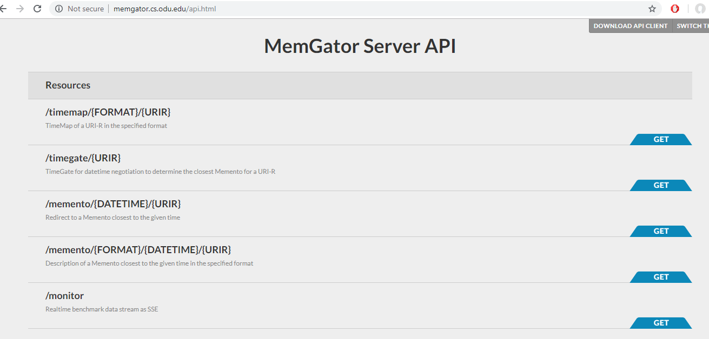
Play with TimeMap and TimeGate
Source: http://memgator.cs.odu.edu/api.html

Slide 27
Code to fetch TimeMap for any Twitter handle
url = "http://localhost:1208/timemap/"
data_format = "cdxj"
command = url + data_format + "/http://twitter.com/<screen-name>" +
response = requests.get(command)

Slide 28
Code to parse tweet-related information
import bs4
soup = bs4.BeautifulSoup(open(<HTML representation of Memento>),"html.parser")
match_tweet_div_tag = soup.select('div.js-stream-tweet')
for tag in match_tweet_div_tag:
if tag.has_attr("data-tweet-id"):
# Get Tweet id
...........
# Parse tweets
match_timeline_tweets = tag.select('p.js-tweet-text.tweet-text')
...........
# Parse tweet timestamps
match_tweet_timestamp = tag.find("span", {"class": "js-short-timestamp"})
...........

Slide 29
Analysis of Breitbart News Deleted Tweets
Of the 22 deleted tweets, 20 were of the form where Breitbart News retweeted someone's tweet but the original tweet was lost.
Of those 20 tweets, 18 were from two affiliates of Breitbart News, @NolteNC and @carney. Therefore, we decided to have a look at both the accounts to determine the reason for their deleted tweets.

Slide 30
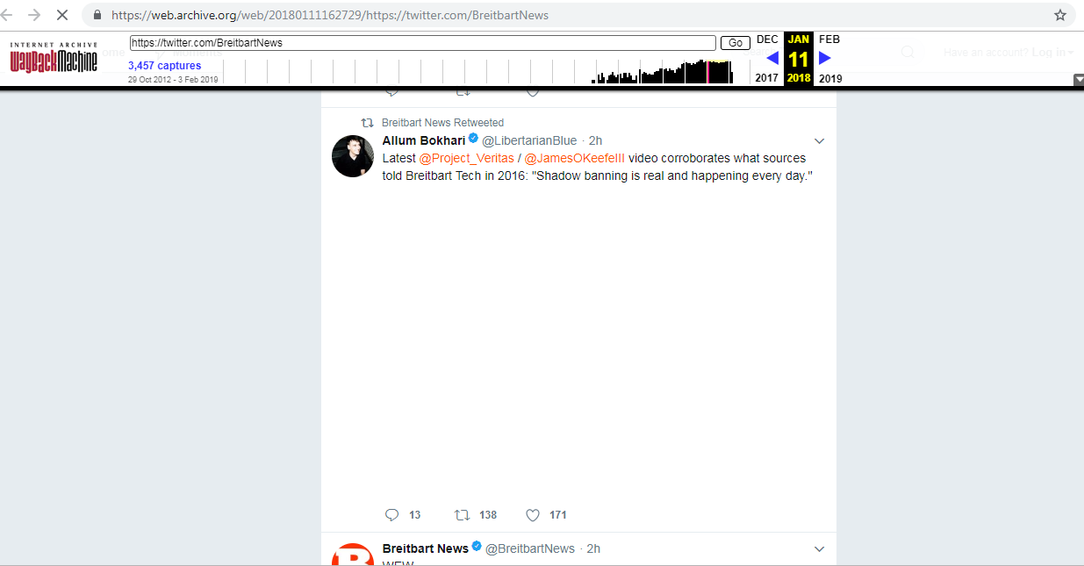
Unretweeted tweet by Breitbart News
Source: https://web.archive.org/web/20180111162729/https:/twitter.com/BreitbartNews

Slide 31

Original Live Tweet
Source: https://twitter.com/LibertarianBlue/status/951465189161029632

Slide 32
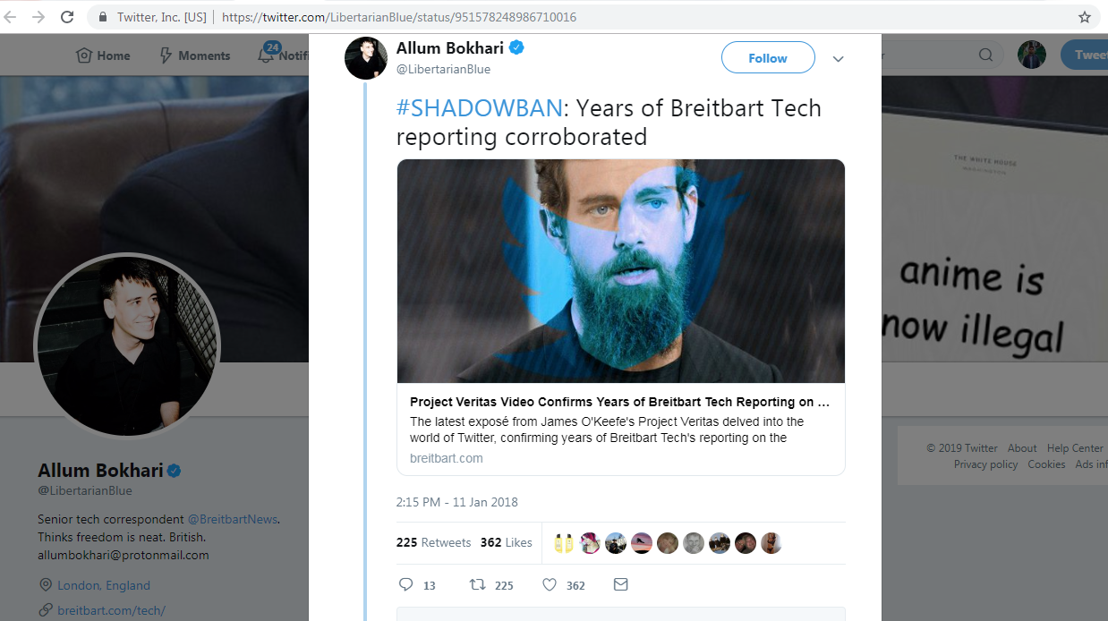
Breitbart News retweets another tweet
Source: https://twitter.com/LibertarianBlue/status/951578248986710016

Slide 33
Analysis on @carney and @NolteNC
Mementos fetched between Nov 3, 2017 and Feb 17, 2018
Low number of mementos for @carney
@NolteNC had 169 live tweets and 3569 deleted tweets
Fetched live tweets using Twitter API for both accounts for over two weeks

Slide 34
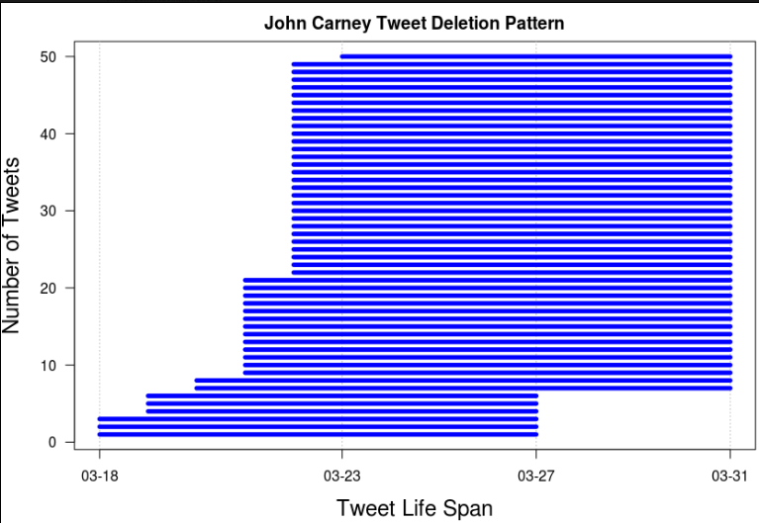
Tweets older than a week on Tuesday and Saturday are deleted

Slide 35
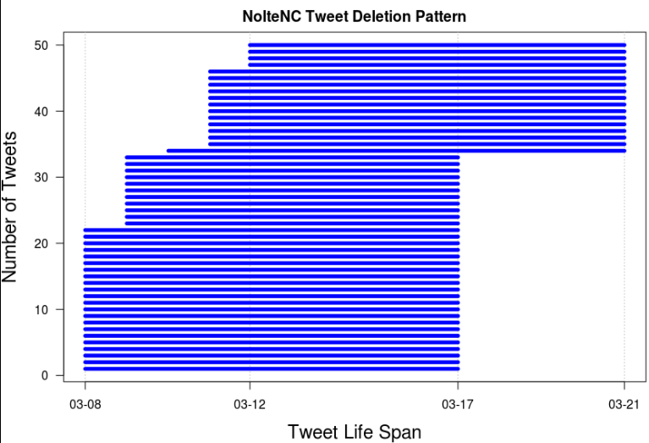
Tweets older than a week on Wednesday and Saturday are deleted

Slide 36
Deletion Behavior
With 1000s of deleted tweets, it seemed unlikely that he was manually deleting tweets.
We have all the reasons to believe that @carney and @NolteNC deleted tweets automatically using some tweet deletion service.

Slide 37
Take Away
It is not enough to make screen shots of controversial tweets, rather we need to push it to the web archives for longer retention capability than our personal archives.
For finding deleted tweets, web archives work effectively for popular accounts but for less popular accounts this approach might not work.
For finding deleted tweets, top level page works better than individual Tweet Id URLs.
Most deletions for Breitbart News come from automatic deletion of tweets by some of its correspondents.

Slide 38
You can read more on the blog
http://ws-dl.blogspot.com/2018/04/2018-04-23-grampa-whats-deleted-tweet.html

